Slide 1
Lunch Menu Recommendation Result & Implementation
Jaeseok Shin 202010116

Slide 2
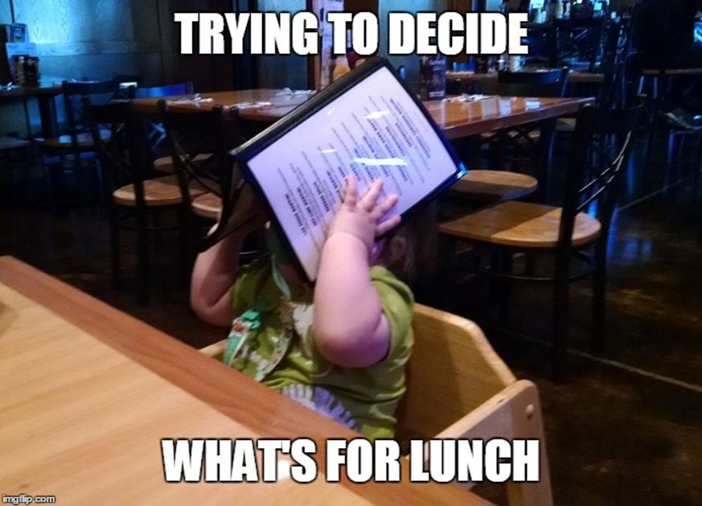




Reminding my topic
Read by user
Recommend
to user
similar options
Problem of deciding lunch menu
Offering various options based on select
Use the Content-Based
Filtering

Slide 3
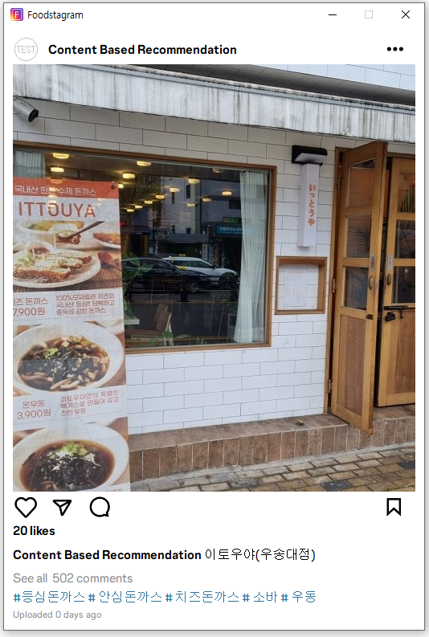
Overview
Based on Star Point Rate
Similarity Measure Algorithms
Instagram-like User Interface

Slide 4
Similarity Method
Cosine Similarity
Image of
Similarity evaluation screenshot
- abcd
- efg
- higk
- lmnop

Slide 5

Method Comparison
 | Cosine | Manhattan (L1) | Euclidean (L2) | Minkowski (LN) | Jaccard
Similarity

Slide 6
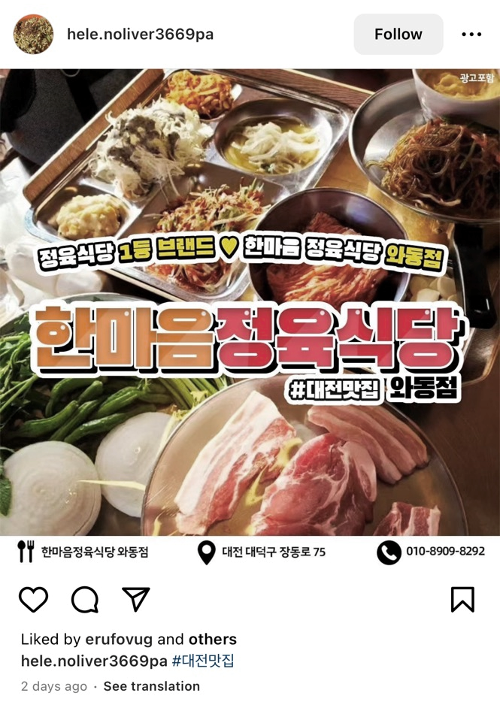
Interface Motivation
Effective information delivery
Familiar user interface
Feedback of last semester
Original Shape
Developed Shape

Slide 7
Similarity Method
Restaurant Image
:
Name of Restaurant
:
①
Similarity
:
Menu of the restaurant
:
⑤
Number of star point
:
②
④
③
⑤

Slide 8




Limitation & Further Development
User selection is not
accumulated
Menu should be
recommended
Gather more data,
Try other method
Sharing function
to other social networks

Slide 9
Reference
Silde 2 image source: https://i.imgflip.com/prhku.jpg
Slide 5 hamburger icon : Created by Hyo-Jung Kang in Noun project
Slide 5 Sandwich icon : Estevao Sarcinelli from Noun Project
Slide 5 Salad icon : WEBTECHOPS LLP from Noun Project

